Slide 1


Slide 2
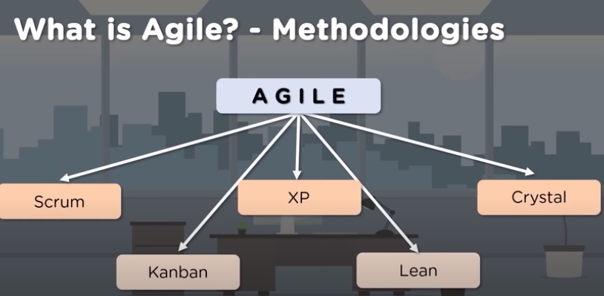

Slide 3
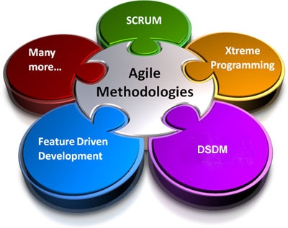

Slide 4
There is a common misconception that Agile is Scrum. While Scrum is indeed agile, it is not the sole method of implementing agile principles. Scrum is simply one of many agile approaches to product development.
A helpful metaphor(example) would be to think of Agile as being ice cream, while Scrum, XP, Crystal, etc., are all simply different flavors, like chocolate, strawberry, vanilla. They are all agile, they are all good, and many can be used in combination.
Simply put, Scrum is an agile method of iterative and incremental product delivery that uses frequent feedback and collaborative decision making.
1) Scrum
2)Kanban
3) Extreme Programming (XP)
4) Crystal
5) Dynamic Systems Development Method (DSDM)
All of these methods adhere to the Agile Manifesto and its associated principles.

Slide 5
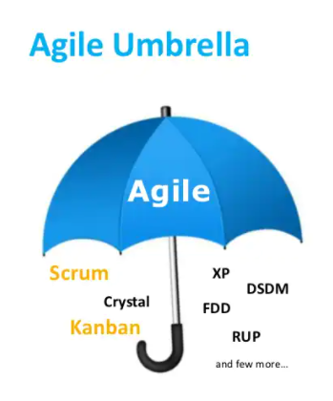

Slide 6
Scrum is one of the leading Agile software development processes. Scrum has been recognized as one of the best project management frameworks for handling rapidly changing or evolving projects, especially those with technology or requirements uncertainty.
What is Scrum?
Scrum is a framework that helps agile teams to work together. Using it, the team members can deliver and sustain the complex product. It encourages the team to learn through practice, self-organize while working on the problem. Scum is a work done through the framework and continuously shipping values to customers.
It is the most frequent software that is used by the development team. Its principle and lessons can be applied to all kinds of teamwork. Its policy and experiences is a reason of popularity of Scrum framework. The Scrum describes a set of tools, meetings, and roles that help the teams structure. It also manages the work done by the team

Slide 7
Scrum commonly used terms:
Product Owner
Scrum Master
Scrum Team
User Story
Product Backlog
Sprint
Sprint Backlog
Sprint Planning Meeting
Daily Stand-up, Sprint Review & Team Retrospective Meetings
Burndown Charts
Impediments

Slide 8
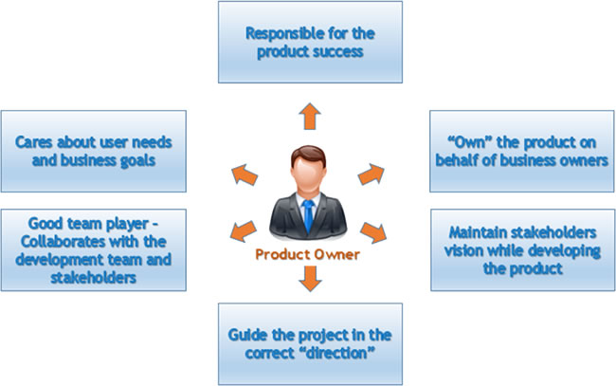
Product Owner
The Scrum product owner is typically a project’s key stakeholder(Participant). Part of the product owner responsibilities is to have a vision of what he or she wishes to build, and convey that vision to the scrum team.

Slide 9
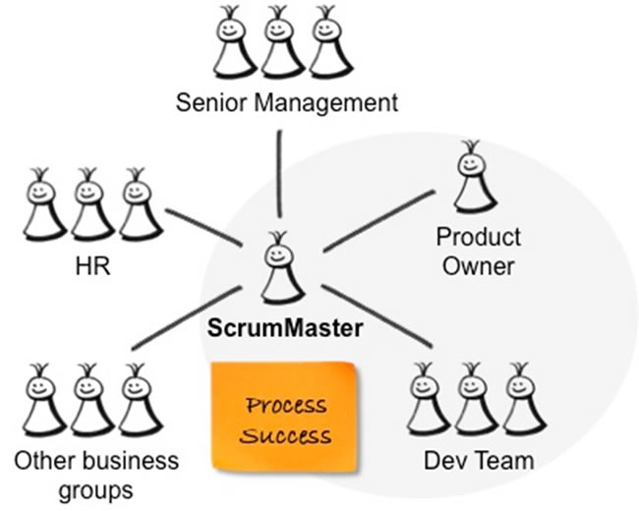
Scrum Master
A scrum master is the facilitator for a product development team that uses scrum. The scrum master manages the process for how information is exchanged.

Slide 10
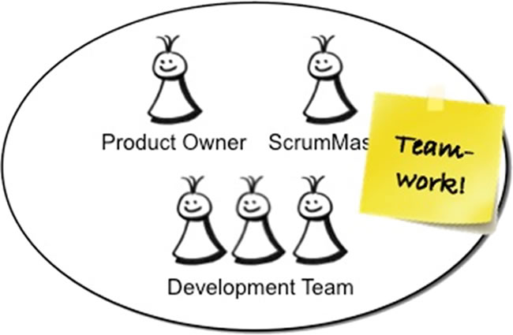
Scrum Team
A Scrum Team is a collection of individuals working together to deliver the requested and committed product increments.

Slide 11
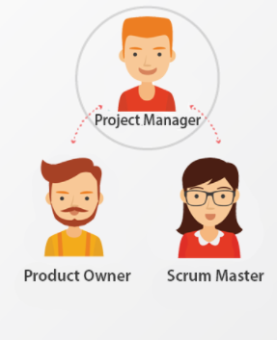
The project manager often becomes the ScrumMaster. This is not always the case and there are many different transformation permutations.
For example, a project manager who has been serving as a domain or subject matter expert might be better positioned as the Product Owner. Or a project manager heading up a team of 50+ people may remain in that role and focus on overall project tasks such as procurement(tracing) and contract negotiation, while the Scrum teams on the project (remember, a Scrum team is 7 +/- 2 people, so a 50-person project will be made up of 6-10 Scrum teams) each have their own ScrumMaster.

Slide 12
Roles and Responsibilities
There are only three roles in Scrum: the ScrumMaster, the Product Owner, and the Team.
The ScrumMaster is the keeper of the process, the advocate for the team, and the protector of the team. They remove obstacles, facilitate team communication, mediate discussions within the team and negotiate with those external to the team. Above all, they exist in service to the team.
The Product Owner represents the voice of the customer and has the authority to make decisions about the product. This person owns the product backlog and is responsible for communicating the vision to the team, and defining and prioritizing backlog items. The Product Owner works with the team on a daily basis to answer questions and provide product guidance.
The Team consists of seven plus or minus two people who are jointly responsible for the delivery of the product. They own the estimates, make task commitments, and report daily status to each other in the daily scrum. They are self-organizing, meaning that structure appears without explicit intervention from the outside.

Slide 13
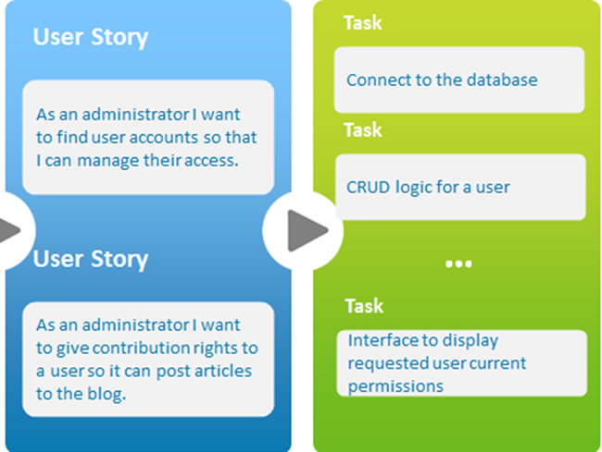
User Story
A user story is a way used in Scrum to capture a description of a software feature from an end-user perspective. The User story describes the type of user, what they want and why. A user story helps to create a simplified description of a requirement.

Slide 14
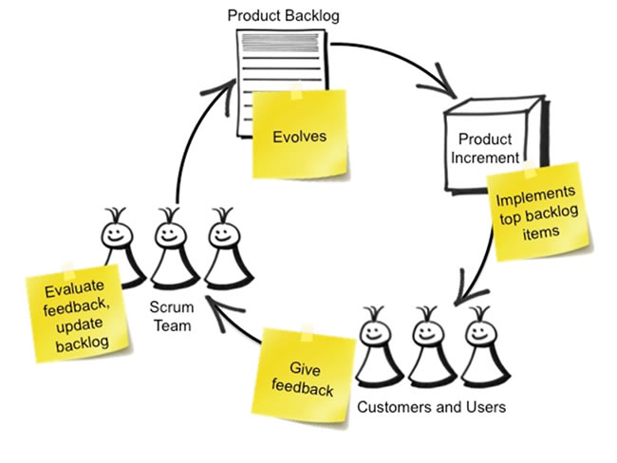
Product Backlog
Product Backlog is simply a list of all things that needs to be done within the project.
Product Backlog Items (PBIs) are usually sorted by value, risk, priority, and necessity. It is a sequence of highest to lowest priority, with each entry having a unique order. Product to-do list entries at the top need to be developed immediately. The higher the ranking, the more urgent the product to-do list entry is, the more you need to think carefully and the more consistent your opinion on the value.

Slide 15
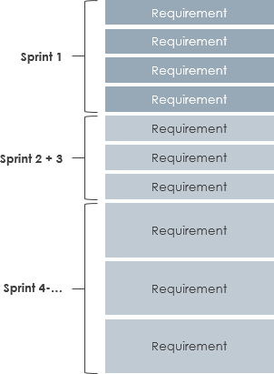

Slide 16
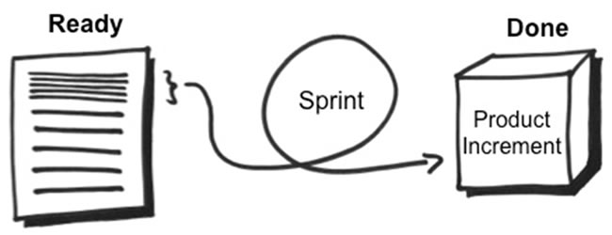
Sprint
In the Scrum method of Agile software development, work is confined to a regular, repeatable work cycle, known as a sprint or iteration. Scrum sprints used to be 30 days long, but today many teams prefer shorter sprints, such as one-week or two-week sprints.

Slide 17
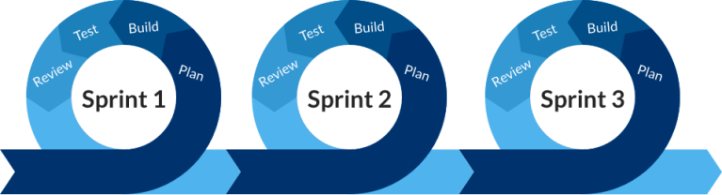

Slide 18
What are sprints?
With scrum, a product is built in a series of repetition called sprints. It breaks down big complex projects into bite-size pieces. It makes projects more manageable, allows teams to ship high quality, work faster, and more frequently. The sprints give them more flexibility to adapt to the changes.
Sprints are a short, time-boxed period for Scrum team that works to complete a set amount of work. Sprints are the core component of Scrum and agile methodology. The right sprints will help our agile team to ship better software.

Slide 19
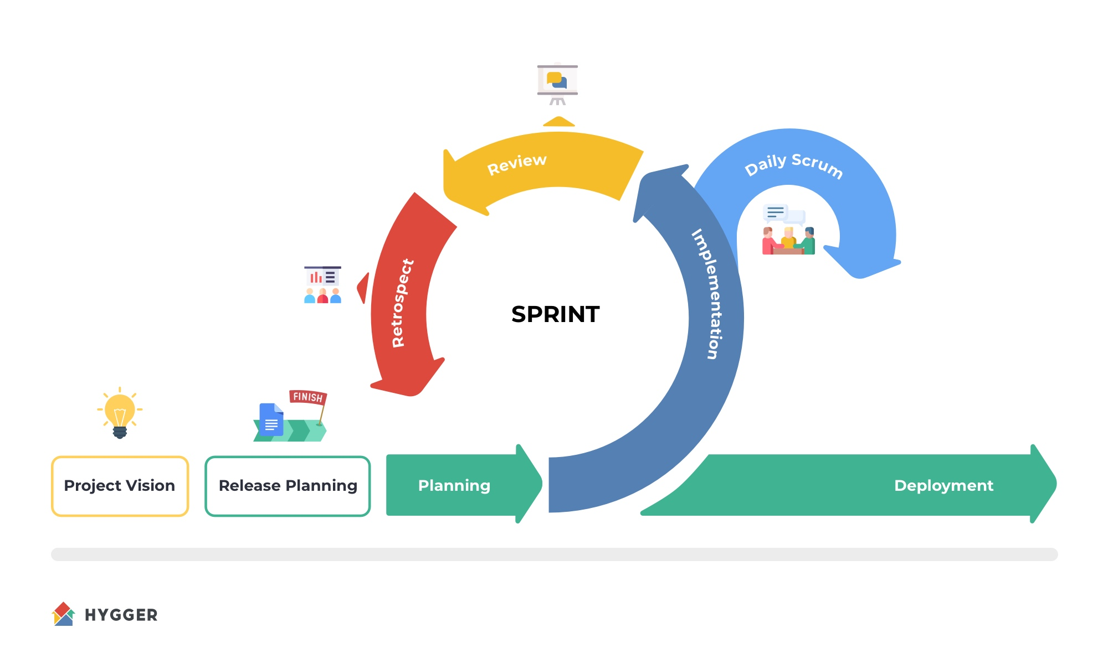

Slide 20
What is sprint plan?
Sprint plan is an action in Scrum that kicks off the sprint. The primary purpose of sprint plan is to define what can deliver in the sprint. It also focuses on how the work will be achieved. It is done in combination with the whole Scrum team members.
The sprint is a set of the period where all the work to be done. Before we start the development, we have to set up the sprint. We need to describe how long time is required to achieve the sprint goal and where we are going to start.

Slide 21
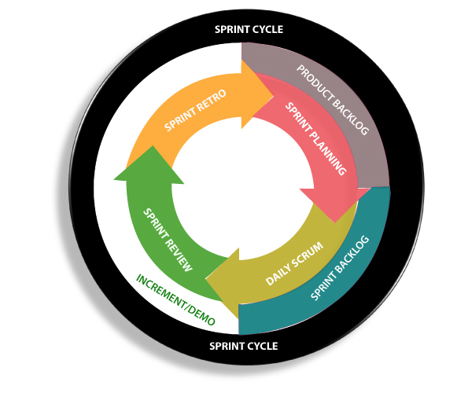

Slide 22
Factors affecting Sprint planning
The What: The product owner describes the goal of the sprint and the backlog items which contribute to achieve that goal.
The How: Agile development team plans its necessary work on how to achieve and deliver the sprint goal.
The Who: The product owner defines the goal based on the value that the customers seek. And the developer needs to understand how they can or cannot deliver that goal.
The Inputs: The product backlog provides the list of input stuff that could potentially be part of the current sprint. The team looks over the existing work done in incremental ways.
The Outputs: The critical outcome of sprint planning is to meet described team goal. The product set the goal of sprint and how they will start working towards the goal.

Slide 23
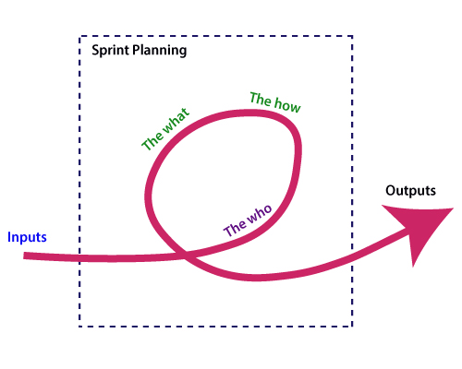

Slide 24
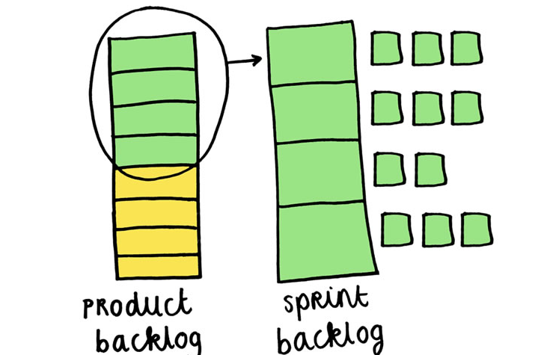
Sprint Backlog
The sprint backlog is a list of tasks identified by the Scrum team to be completed during the Scrum sprint.
During the sprint planning meeting, the team selects some number of product backlog items, usually in the form of user stories, and identifies the tasks necessary to complete each user story.

Slide 25
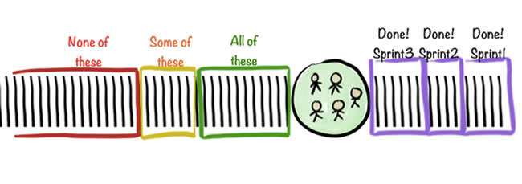
Sprint Planning Meeting
The Sprint Planning Meeting is the first meeting to kick off the sprint. It is attended by the ScrumMaster, Development Team and the Product Owner, along with interested and invited stakeholders.

Slide 26
Backlog starts with the two "R"s
The fundamental product backlog is provided by a team's roadmap and requirements. Roadmap repetition breaks down into several epics, and each epic will have several requirements and user stories.
The product owner organizes each of the customer stories into a single list. This story is organized for the development team. The product owner chooses to deliver first complete epic.

Slide 27
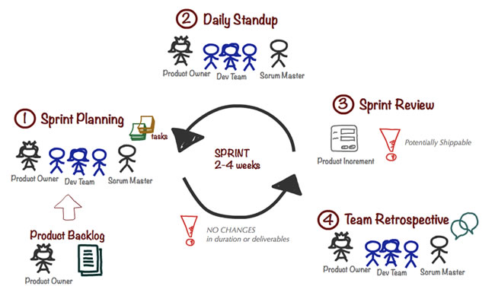
Daily Standup, Sprint Review & Team Retrospective Meetings
The daily Scrum meeting is a short everyday meeting, ideally during start of the working day. Each team member who works towards the completion of a given sprint needs to participate. During this meeting, each team member should briefly provide the answers of the following three questions:
– What has he/she accomplished since the last daily Scrum meeting? – What is he/she is going to accomplish until the next Scrum meeting? – What are the impediments(obstacles) that prevent he/she from accomplishing his/her tasks?

Slide 28
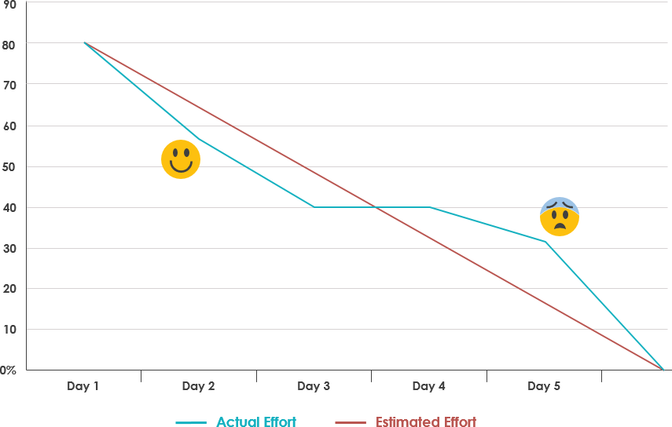
Burndown Charts
What is Burndown Chart in Scrum?
A burn down chart is a graphical representation of work left to do versus time. It is often used in agile software development methodologies such as Scrum. However, burn down charts can be applied to any project containing measurable progress over time.

Slide 29

Impediments
An Impediment is anything that keeps the Team from getting work Done. Impediments come in many forms:
– A sick team member – A missing resource – Lack of management support – Even a cold team room or Slow connection
If it’s blocking the team from doing its work, it’s an Impediment.

Slide 30
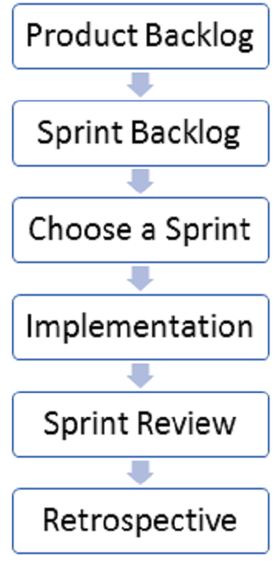
SCRUM FLOW

Slide 31
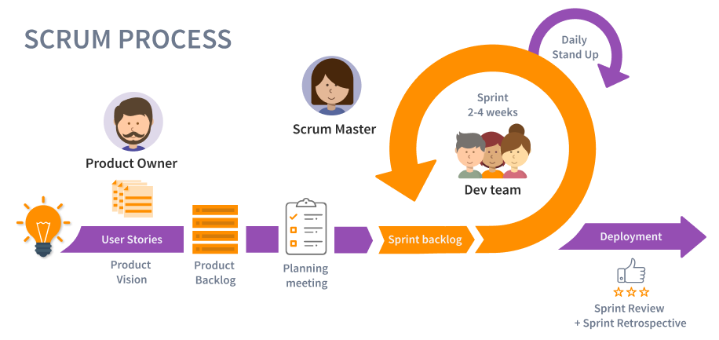

Slide 32
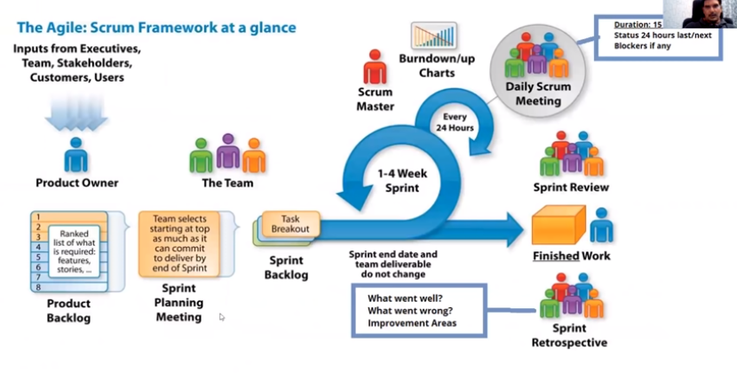
The Scrum Framework
SCRUM

Slide 33
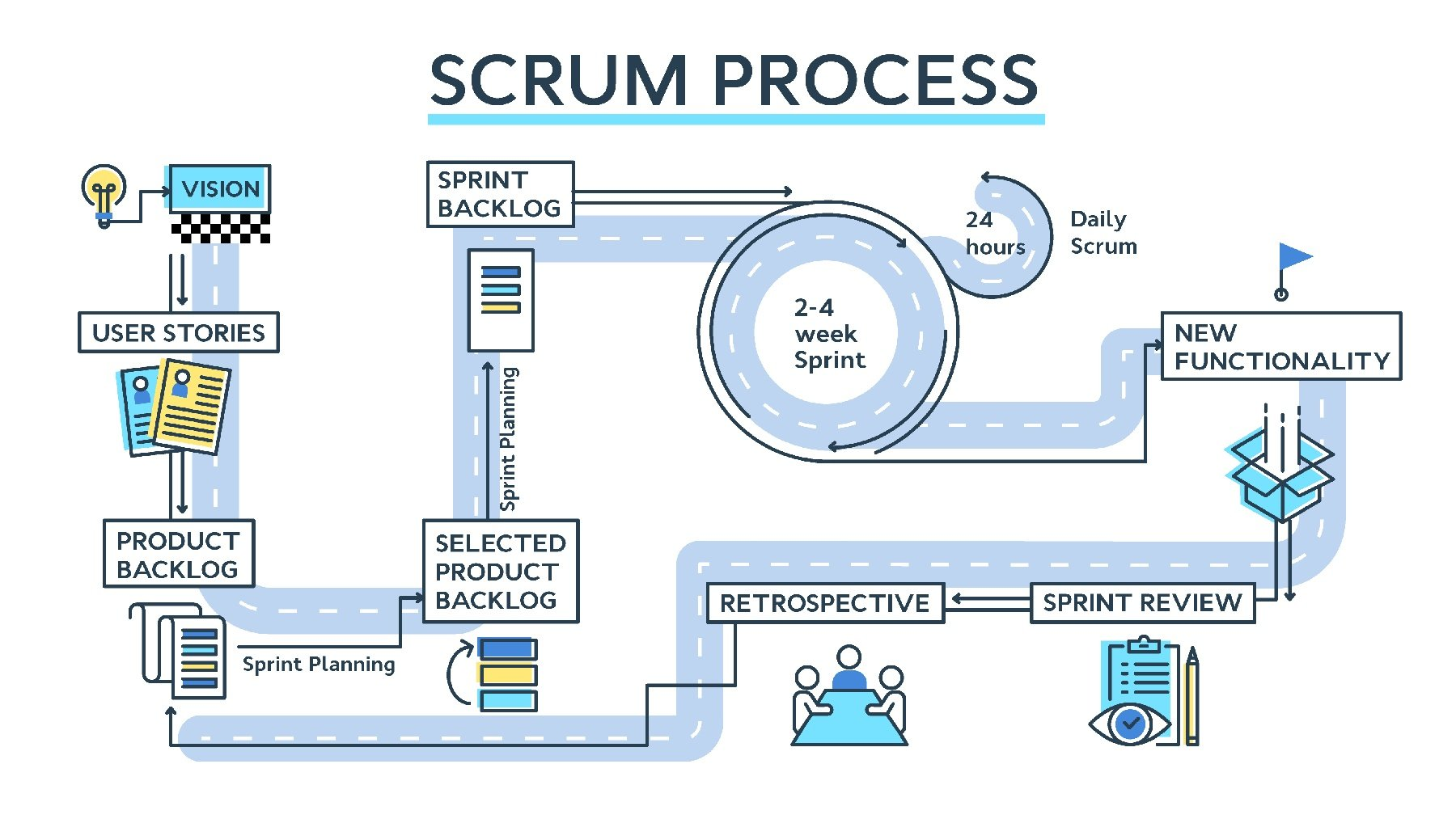

Slide 34
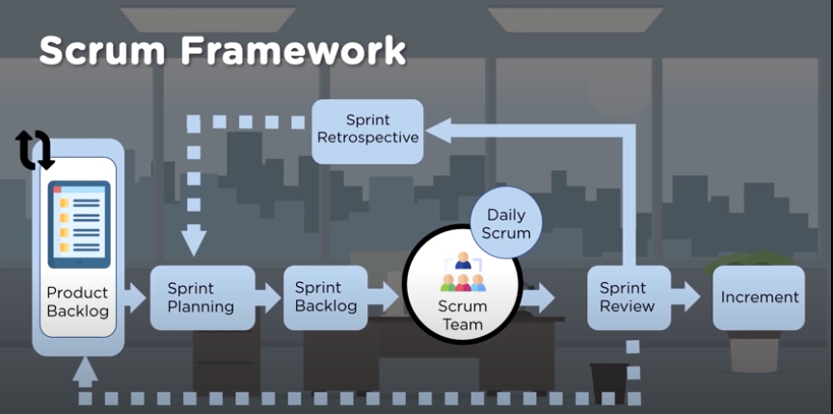

Slide 35
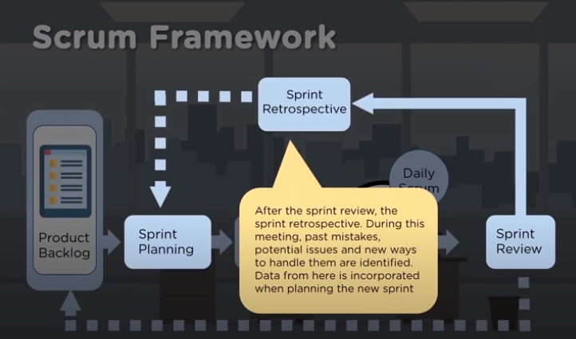

Slide 36
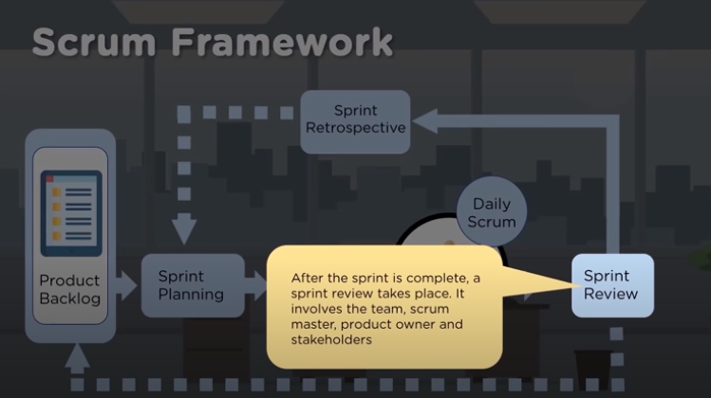

Slide 37
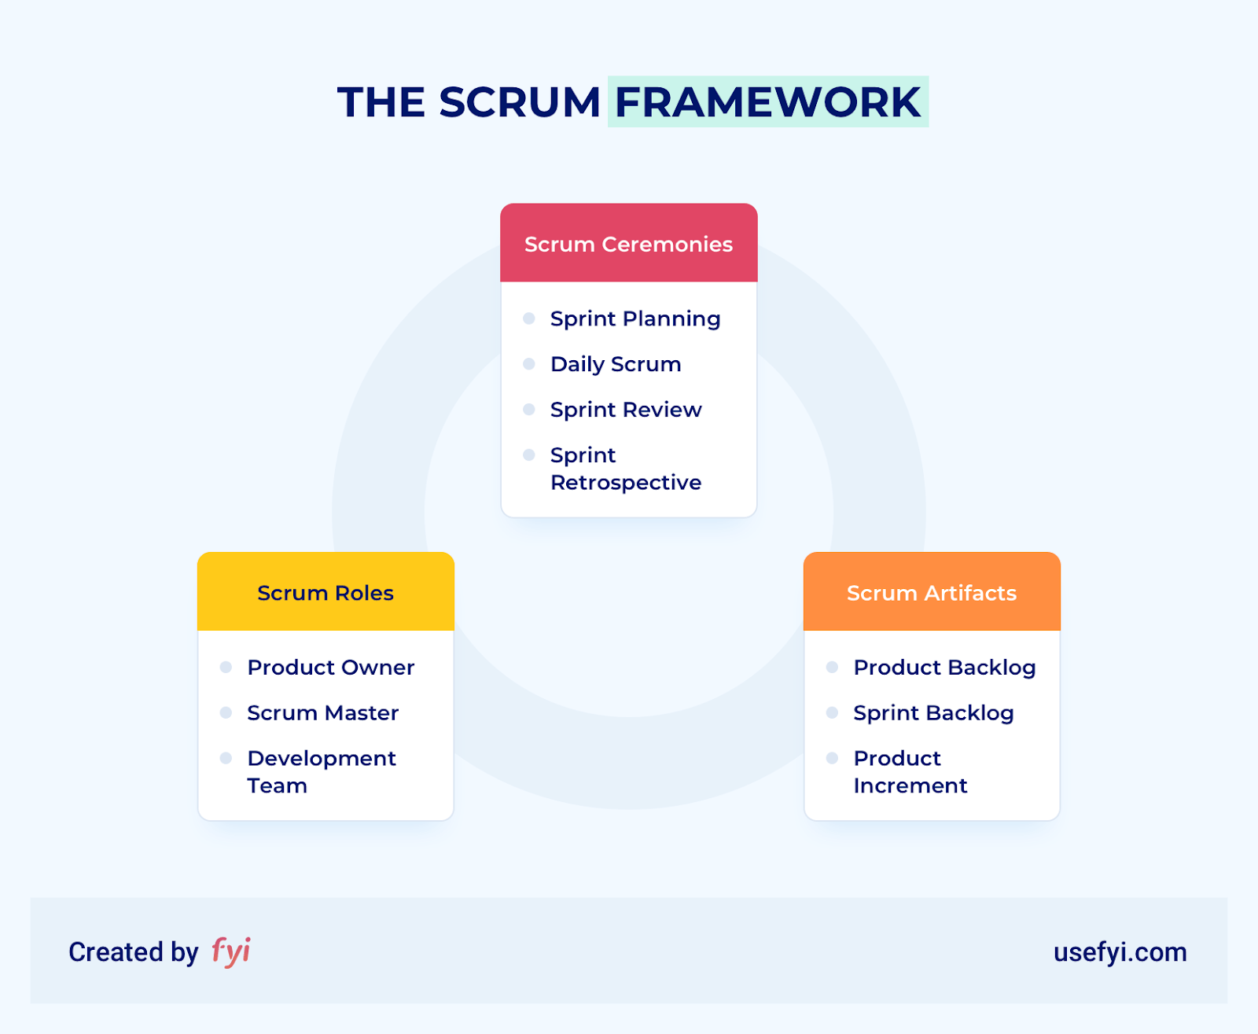

Slide 38
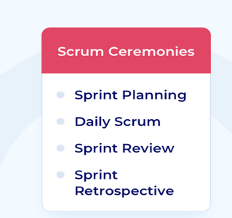
The 4 Scrum ceremonies
1. Sprint planning
The first Scrum ceremony is sprint planning. It marks the beginning of the sprint and is timeboxed according to the number of weeks in the sprint. Typically, this is two hours per week of sprint duration. A team with a two-week sprint cadence, for example, would dedicate four hours to sprint planning.
At this ceremony, there are two main objectives:
The Scrum team decides what items from the product backlog to pull into the current sprint backlog.
The development team forms a plan for delivering the selected backlog items.

Slide 39
2. Daily Scrum
The second Scrum ceremony, daily Scrum, occurs on every day of the sprint when there isn’t another ceremony. It’s timeboxed at 15 minutes, during which the team comes up with a plan for the next 24 hours.
Tip: Hold daily Scrum at the same time and in the same place each day. The predictability reduces complexity, uncertainty, and helps individual members self-organize according to their own schedule.
Daily Scrum includes the development team, who run the meeting, and the Scrum master. A product owner may attend if helpful. If they don’t, the Scrum master should keep them informed of any major adjustments that might impact the sprint.
The key is to keep this ceremony brief. Daily Scrum isn’t a time for new ideas or one-on-one conversations. During daily Scrum, the team focuses on inspecting progress and identifying any changes to the day’s work. Each member of the development team explains:
What they have done since the last daily Scrum.
What they will work on today.
Any problems preventing them from accomplishing their work.

Slide 40
3. Sprint review
At the end of the sprint, the Scrum team holds sprint review. The entire team attends, as well as any stakeholders invited by the product owner.
The purpose of sprint review is to inspect the newly created product increment and adapt the product backlog as necessary. By the end of sprint review, the Scrum team should have a revised product backlog and a good sense of what items to move to the upcoming sprint.
During sprint review, the product owner and team explain the backlog items they completed. What work is now “done”? What does that “done” increment offer users? With the Scrum team and key stakeholders in one place, sprint review is the perfect opportunity to talk about the progress you’re making on the product.
It’s also a great time to reflect on the utility of the product backlog. Is the team slated to work on the most pressing thing next? What changes need to be made to the product backlog as a result of the work completed? What impediments or new opportunities did you discover during the sprint, and how do they impact the road ahead?
In short, you want to leave sprint review positive that the current product backlog is set up to best use the Scrum team’s resources. The team should feel they are working on items that deliver value and the other stakeholders should agree.

Slide 41
4. Sprint retrospective
After sprint review, but before the next sprint, the team holds the final scrum ceremony: the sprint retrospective, also known as the agile retrospective. Just as the sprint review offers a moment for the team to inspect and adapt the product it’s making, the sprint retrospective is a space for the team to reflect on its process.
Retrospectives are usually timeboxed at 30-45 minutes (depending on team size) per week of sprint duration, though some teams opt to keep retrospectives in this timebox regardless of their cadence.
The Scrum master ensures all team members are present. The product owner may be present, but it’s not mandatory. No need for other stakeholders to attend, either. In fact, some teams might feel uncomfortable inspecting their internal processes under outsiders’ eyes.
The purpose of a sprint retrospective is to improve team processes. Every member of the development team should be given space to:
Talk about the efficacy of the relationships, processes, and tools the team used to complete the work of the sprint.
Discuss what worked well and what did not.
Come up with a plan for the next sprint that capitalizes on pros and addresses cons.
A well-run retrospective will help the team bring potential problems to the surface so they don’t persist in future sprints. This Scrum ceremony is the perfect opportunity to get issues out in the open. Are relationship problems causing problems? Have antipatterns started to develop?
The development team runs the retrospective, though the Scrum master facilitates it. Together, they work to identify areas of improvement and agree on changes for the next sprint.

Slide 42
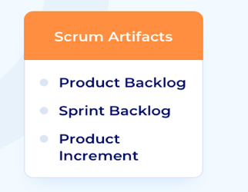
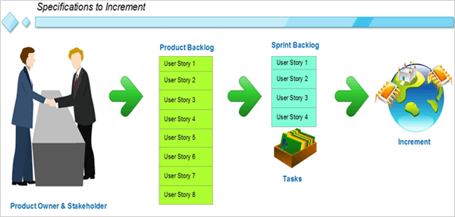
Different Scrum Artifacts
3 types of scrum artifacts include:
Product backlog
Sprint backlog and
Product increments
Now we will see what these terms mean and how to create these artifacts.

Slide 43
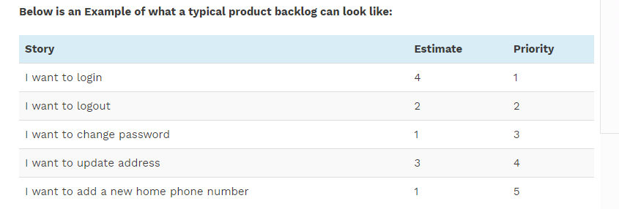
Product Backlog
To put it in simple terms, a product backlog is a list of all the things that are required in the product. It’s the final document to be referred to by the scrum team for anything related to the product. It’s an ordered list of items which is owned by the Product Owner (PO).
The PO is responsible for creating, maintaining and prioritizing this list. The POs use this product backlog to explain the top requirements that need to be done during the sprint to the scrum teams.
The items in this list may or may not be in a technical language. It can even be a layman’s language, but it should contain all the product requirements and the accompanying changes. Also, having a product backlog doesn’t mean that the scrum team will only have this artifact to follow.
They can create their own detailed artifacts but those won’t contradict or replace the product backlog. They will rather be in an alignment with the product backlog requirements.

Slide 44
A product backlog should ideally follow the below rules:
(i) It should be prioritized – The items in the product backlog should be ordered as per their priority. This priority can be decided by the PO and the scrum team together. The prioritization factors can be any like benefit from the story point, the effort involved in the creation, complexity, customer priority etc.
It helps the team in understanding what needs to be delivered first.
(ii) It should be estimated – The stories should always be estimated as per the agreed definition, whatever that might be. This can be used for prioritization as well.
(iii) It should be high level – The stories in the product backlog are meant to be high level and should not go into the details. Creation of detailed user stories as per the requirement is up to the scrum team and not the PO.
(iv) It should be dynamic – The product backlog is not a final static document. It should be revisited as the PO receives inputs from the scrum team and the customer requirements become more and more clear. Thus the document requirements are not frozen right at the beginning because there are additions/ deletions/modifications expected as the project progresses.

Slide 45
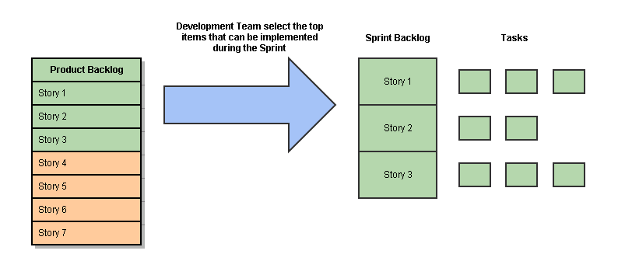
Sprint Backlog
You might remember that the scrum teams work in short iterations of 2 to 4 weeks called a sprint. During these sprints, the scrum team identifies the items from the product backlog created by the PO, which they plan to deliver as a part of the next iteration. The items which the scrum team selects to work upon become a part of the sprint backlog.
Thus they decide what functionalities are going to be there in the next iteration of the product. The scrum team is the one who decides what will go into the sprint backlog as they are the ones who are going to work on it.

Slide 46
Product Increments
A goal of the scrum process is to develop features in such a way that the product is in a completed state at the end of every sprint, so it could be released, demonstrated to clients for feedback, or used as a tool for testing. While it’s not mandatory for an organization to release the product according to the schedule of scrum, this goal allows the state of the product to be part of the iterative process of development, testing, evaluation, and innovation that scrum encourages.
The Increment is the sum of all the Product Backlog items completed during a Sprint and the value of the increments of all previous Sprints.
“DONE” INCREMENT
Every new Increment needs to be “Done”. It means that it needs to meet the Definition of “Done” created by the Scrum Team.
The main role of the definition of “Done” is to increase and support high quality of the increment. Definition of “Done” is created by the Development Team’s to have a common understanding about completed work and to ensure transparency.
What is more, definition of “Done” helps the Development Team’s to select the right number of Product Backlog items into Sprint Backlog during Sprint Planning session.

Slide 47
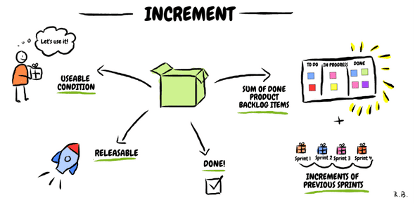
Increment is sum of all items completed within the Sprint + value of increments from previous iterations
When Increment is created, definition of “Done” needs to be met
Decision about releasing the Increment is in the Product Owner’s hands, but it needs to be in useable/releasable state.

Slide 48
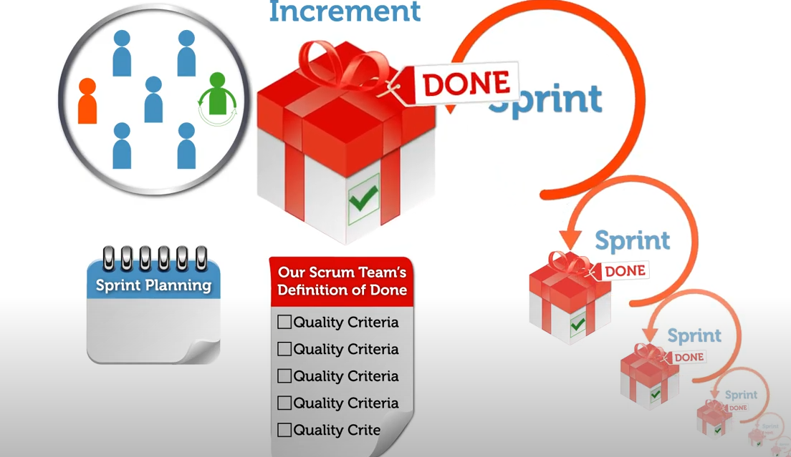

Slide 49
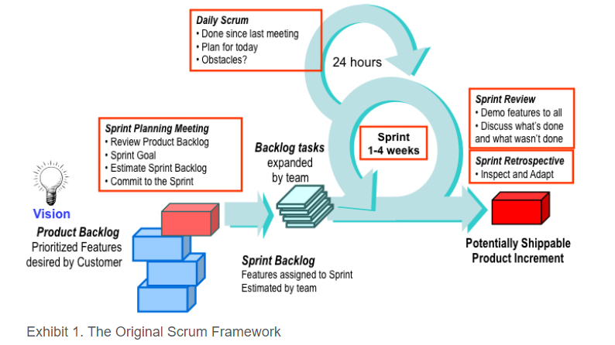

Slide 50
Exhibit 1. The Original Scrum Framework
The project begins with a clear vision provided by the business, and a set of product features in order of importance. These features are part of the product backlog, which is maintained by the customer or customer representative referred to as the Product Owner. A time box commonly referred to as an iteration or sprint, is the set amount of time that the team has to complete the features selected.
Sprints are generally from one to four weeks in length, and that length is maintained throughout the life of the project so as to establish a cadence. The team selects items from the product backlog that it believes can be completed in the sprint, and creates a sprint backlog consisting of the features and tasks as part of the sprint-planning meeting.
Once the team has committed to a sprint backlog, the task work begins. During this time in the sprint, the team is protected from interruptions and allowed to focus on meeting the sprint goal. No changes to the sprint backlog are allowed; however, the product backlog can be changed in preparation for the next sprint.

Slide 51
During the sprint, the team checks in daily with each other in the form of a 15-minute meeting known as a scrum. The team stands in a circle and each member states what they did yesterday, what they plan to do today, and what is getting in their way.
At the end of the sprint, the team demos the work they have completed to the stakeholders and gathers feedback that will affect what they work on in the next sprint. They also hold a retrospective to learn how to improve. This meeting is critical, as its focus is on the three pillars of Scrum: transparency, inspection, and adaptation.

Slide 52
The Application of Scrum
Scrum is applied by following a set of ceremonies, or meetings. Required Scrum ceremonies include the sprint planning meeting, the daily scrum, the sprint review and the sprint retrospective. Working in time boxes called sprints is also required. Release planning meetings are optional and allow for the planning and forecasting of groups of sprints.
Sprint Planning Meeting
The sprint-planning meeting is held on the first day of every sprint. The ScrumMaster, Product Owner, and Team are all in attendance. The Product Owner presents the set of features he or she would like to see completed in the sprint (the “what”) then the team determines the tasks needed to implement these features (the “how”). Work estimates are reviewed to see if the team has the time to complete all the features requested in the sprint. If so, the team commits to the sprint. If not, the lower priority features go back into the product backlog, until the workload for the sprint is small enough to obtain the team's commitment.
Tracking Progress
Once the sprint-planning meeting is complete and the team has made a commitment, the team begins to track its progress using highly visible information radiators. These radiators include the burndown chart and the task board.
The task board is used by the team to track the progress of the tasks for each feature. The minimum columns used are To Do, Doing, and Done. Teams will have their daily scrum meeting at the task board, and move items across the board when stating what they did yesterday, what they plan to do today, and what obstacles they are grappling with. See Exhibit 2 for an example task board for a software development project.

Slide 53
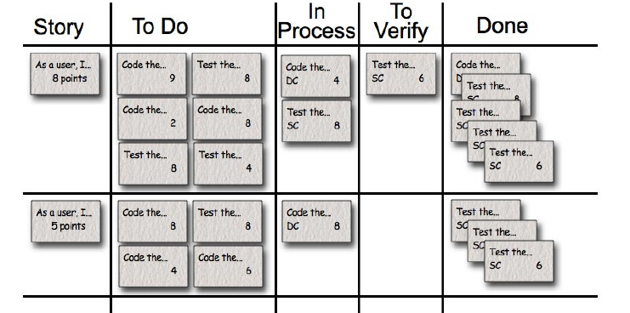

Slide 54
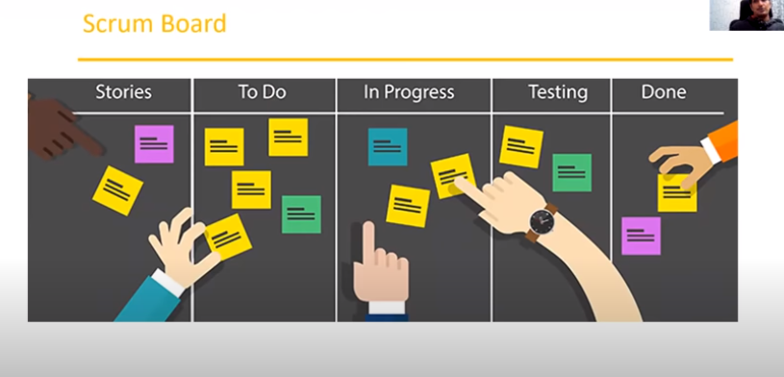
Exhibit 2. Scrum Task Board Example

Slide 55
The burndown chart shows the trend line of the amount of work left to do in the sprint. The x-axis is the number of days in the sprint, and the y-axis is the number of hours for all the tasks that were defined in the sprint-planning meeting. Over the days of the sprint, the line indicating the amount of work left to do should trend down to zero by the last day of the sprint.
See Exhibit 3 for a sprint burndown chart example.

Slide 56
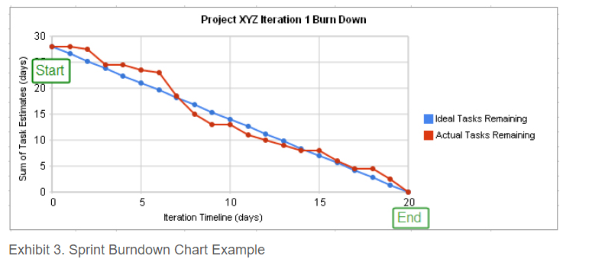

Slide 57
Sprint progress is tracked using the burndown chart, the task board, and the daily scrum. In combination, these three things can provide a clear picture of what's being worked on, what's completed, what's still to be done, whether or not it will be completed in time, and what might be preventing the team from meeting its sprint and/or release goal.
Sprint Review
At the end of the sprint, the team invites stakeholders to a sprint review meeting where the features that were completed in the sprint are demo'd and feedback is requested. The Product Owner keeps track of the feedback and incorporates it as needed into the product backlog.
Once the review is complete, the team (without the stakeholders) conducts a retrospective to determine what they did well that they wish to continue doing, what they struggled with, and what recommendations they have for change going forward. An action plan is created and these items are implemented over the course of the next sprint, and reviewed for efficacy in the next sprint retrospective.

Slide 58
Release Planning
Release Planning is also part of Scrum, and is a way to do long-term planning for a time box that consists of multiple sprints. This is often done quarterly, and the results of the quarter do not have to be a release to the customer, but may simply be an internal release to confirm system integration and validation. Exhibit 4 shows how release planning fits in with the rest of the Scrum framework.
The entire team attends the release-planning meeting, where the Product Owner presents the features she/he would like to see completed in the quarter. The team does not task out these features however, but instead provides gross level estimates to determine what features can be done in what sprint, and how many of these features can be completed by the end of the quarter. Release planning can be feature-driven (how many sprints will it take to complete this set of features?), time-driven (how many features can we expect to have completed by this deadline?) or cost-driven (given this budget, what does our schedule look like and what features will we have done before we run out of money?).

Slide 59
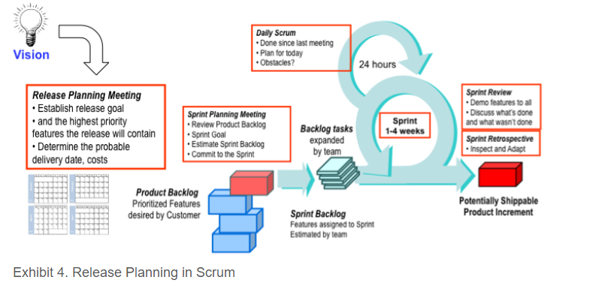

Slide 60
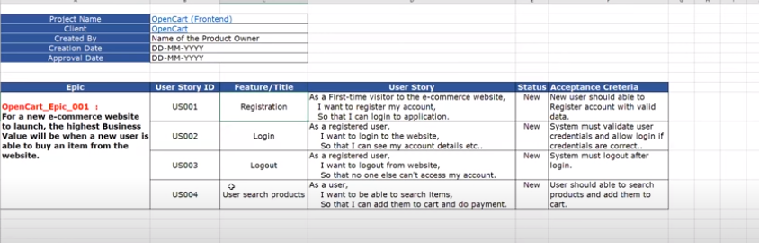

Slide 61
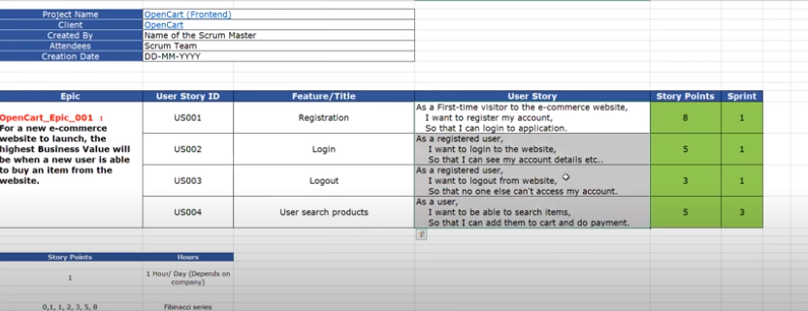

Slide 62
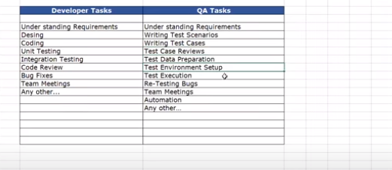

Slide 63
